Slide 1

Tutorial 2: Command Line & Debug Runner
COMP 249 CCCE
Object-Oriented Programming II

Slide 2
Tasks for Today
Expectations from Students
Command Line Interface
Discuss Assignment 0
Run Debug Runner class

Slide 3
Expectations from Students
Hands-on course
You are expected to do most of the course on your own
Lectures are given to learn theory and new concepts
Tutorials are to help you understand the concepts, not give step-by-step solution for labs or assignments (that you have to figure out on your own)
Assignments are given to apply what you learned in class and practice the concepts
If you don’t know something, google it!
For example, a0
Practice! Practice! Practice!
Get into the habit of facing the problem, dividing it into smaller problems, seeking the solution, writing it in pseudo-code and implementing it in code

Slide 4
Why is Command Line Important?
CLI (Command Line Interface) is an important skill to have for this course, future courses (OS course esp) and in your computer science journey (Professor wants you to practice it!)
CLI is an “Industry standard”
It is the similar for Windows, Mac and Linux
F.e. running Java program on different OS or if you don’t have IDE available
GUI (Graphical User Interface) has its limitations
F.e interactions with OS you must use CLI
F.e. administration tasks, using Cloud services, running programs on a server requires CLI
CLI for efficiency and automation
F.e. write scripts inside cmd to automate daily tasks
Summary: Get familiar with CLI early (for now it is very simple!)

Slide 5
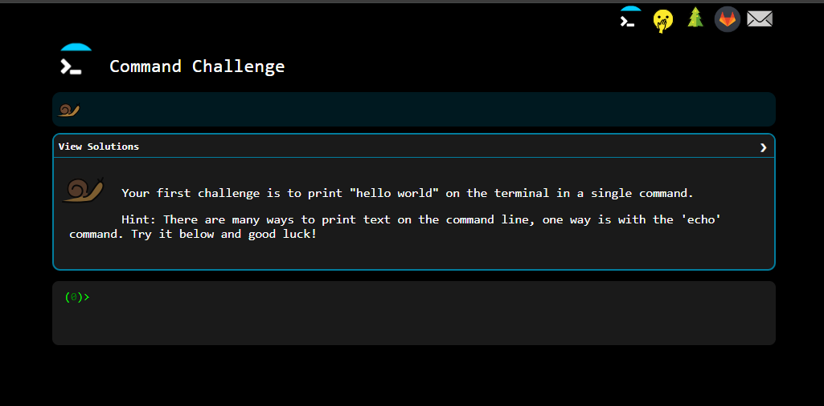
Practice using CLI
Cmd Challenge:
https://cmdchallenge.com/
Your own machine

Slide 6
A0: Command Line
Step 1
Know how to access command line on your machine
Windows: Type cmd in search
Mac: Open Launchpad, search Terminal and select it
Get familiar with basic commands:
dir : List contents of the directory -> Windows
ls : List contents of the directory -> Mac &Linux
mkdir directory_name : Creates a new directory/file
cd directory_name : Go to the specified directory
cd .. : Moves up one directory level
↑ : ‘Up’ key on keyboard shows previous command
notepad file_name.java : opens text editor -> Windows
nano file_name.java : opens text editor -> Mac &Linux
java –version : Prints the current version installed
javac file_name.java: Compiles into byte code & outputs nothing if no errors
java file_name: Runs the code
Note: there is no .java extension!

Slide 7

A0: Follow the Assignment Instructions
Step 2
Create directory (folder) dedicated to your Assignment 0
F.e. myassingment
Extract/copy files from the zip folder of a0
Follow the structure given in the instructions pdf:

Slide 8
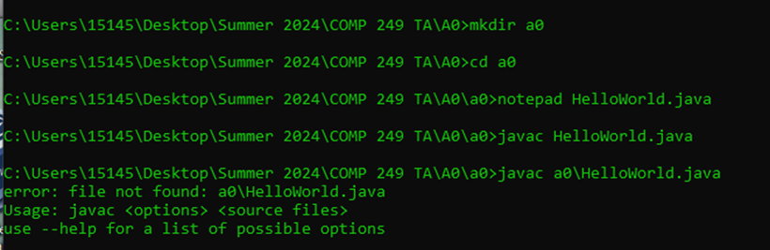
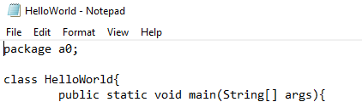
A0: Write your Program in a0 directory
Step 3
Inside Assignment directory create another directory called a0
Go into a0 directory and create your java program HelloWorld.java
To create java program without IDE, type:
- notepad HelloWorld.java for Windows
- nano HelloWorld.java for Mac
Type your program and don’t forget package a0;

Slide 9
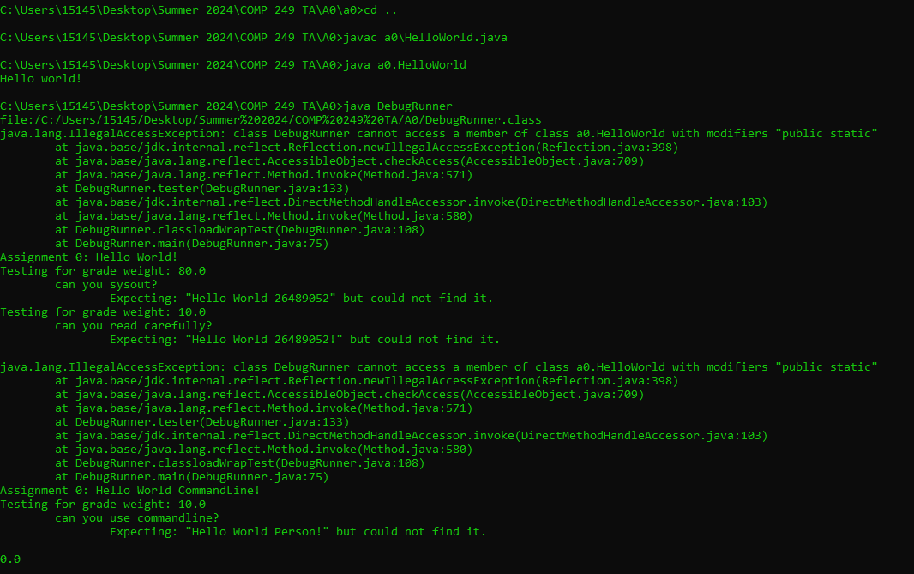
A0: Compile, Run and Debug
Step 4
In command line go up directory and compile your program (it will create HelloWorld.class):
Type javac a0\HelloWorld.java
Run your program and get the output:
Type java a0.HelloWorld
Run DebugRunner and get the score:
Type java DebugRunner

Slide 10
Any Questions? May Your Code Be Bug-Free!

